Slide 1

Hypothesis Testing

Slide 2

Overview
Introduction to hypothesis testing
Principle ideas of the technique
Example
Resources
Notes:
Use white slides to add pictures

Slide 3
Introduction
Scientific claims about reality are called hypotheses.
Any hypothesis should be supported by evidence.
If they are verified by observations, hypotheses are accepted as true, at least until proved otherwise.
Notes:
Use white slides to add pictures

Slide 4
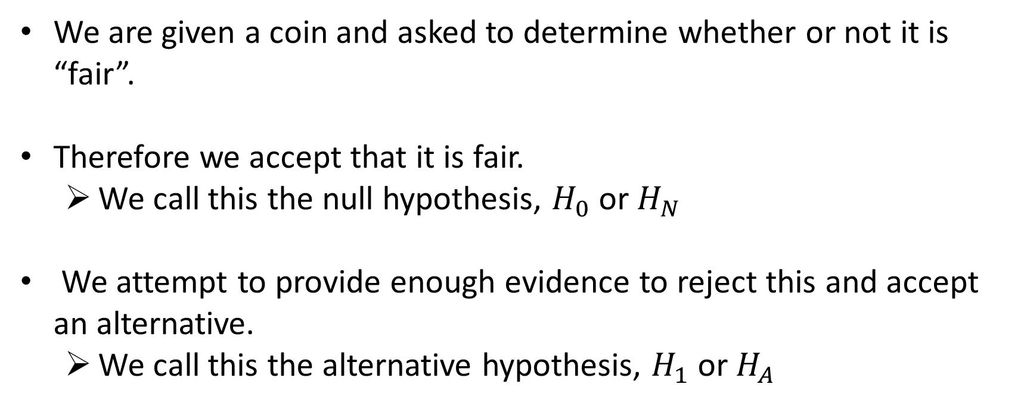
Coin toss
We are given a coin and asked to determine whether or not it is “fair”.
Therefore we accept that it is fair.
We call this the null hypothesis, $H_{0}$ or $H_{N}$
We attempt to provide enough evidence to reject this and accept an alternative.
We call this the alternative hypothesis, $H_{1}$ or $H_{A}$
Notes:
Use white slides to add pictures

Slide 5
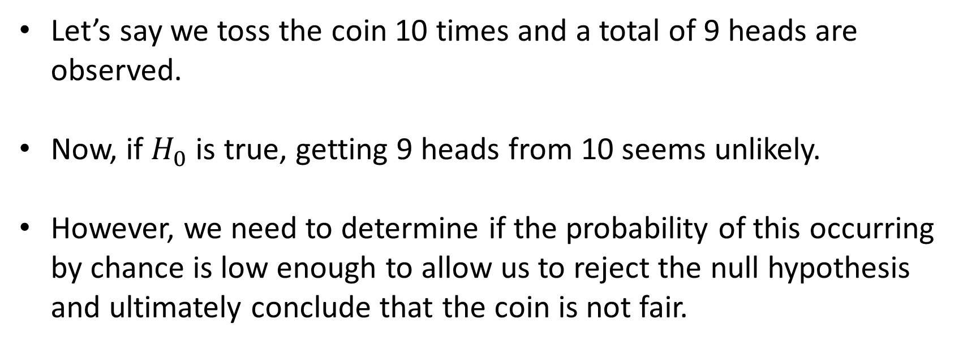
Coin toss
Let’s say we toss the coin 10 times and a total of 9 heads are observed.
Now, if $H_{0}$ is true, getting 9 heads from 10 seems unlikely.
However, we need to determine if the probability of this occurring by chance is low enough to allow us to reject the null hypothesis and ultimately conclude that the coin is not fair.
Notes:
Use white slides to add pictures

Slide 6
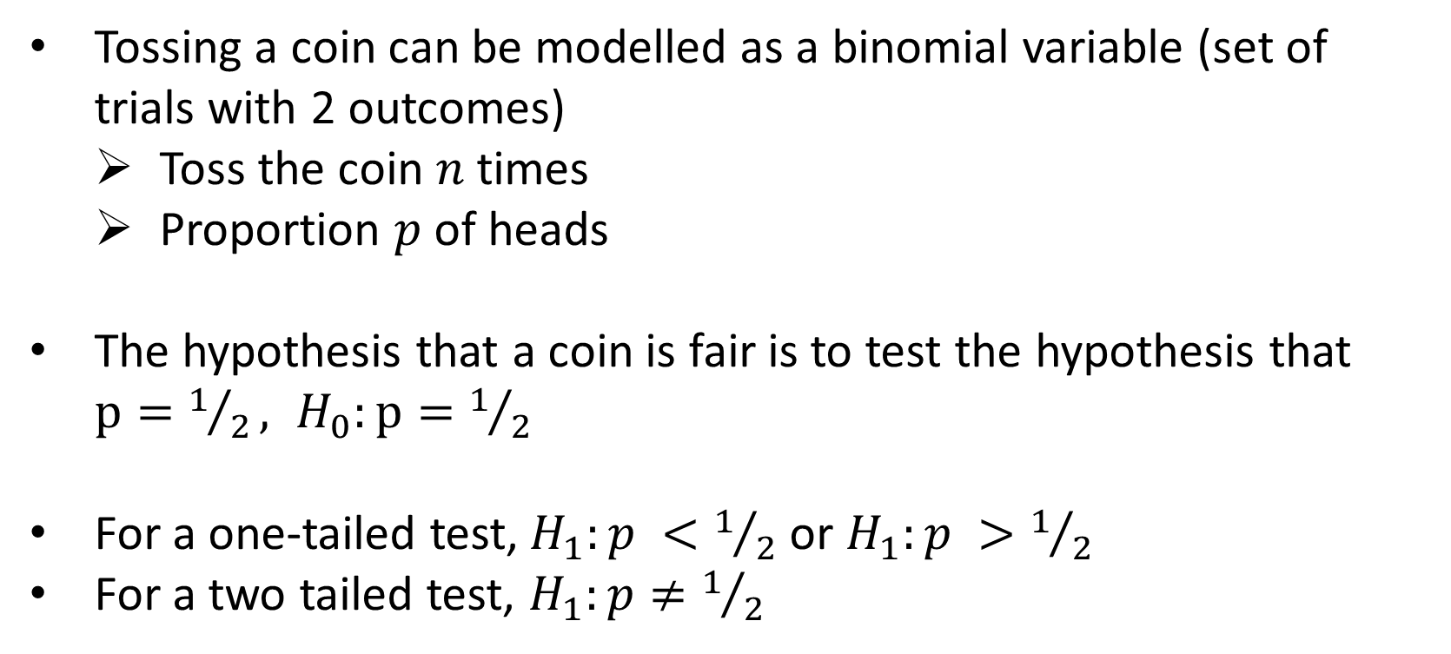
Coin toss
Tossing a coin can be modelled as a binomial variable (set of trials with 2 outcomes)
Toss the coin $n$times
Proportion $p$ of heads
The hypothesis that a coin is fair is to test the hypothesis that $p=1/2, H_{0}:p=1/2$
For a one-tailed test,$H_{1}:p <1/2$ or $H_{1}:p >1/2$
For a two tailed test, $H_{1}:p≠1/2$
Notes:
Use white slides to add pictures

Slide 7
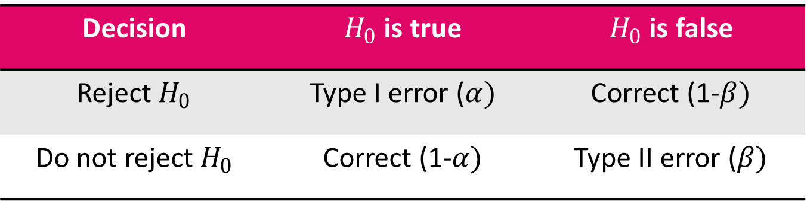
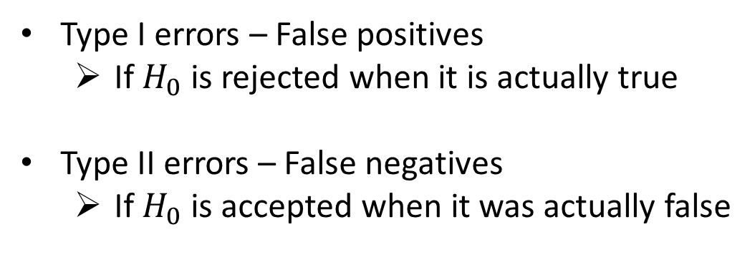
Type I and Type II errors
Type I errors – False positives
If $H_{0}$ is rejected when it is actually true
Type II errors – False negatives
If $H_{0}$ is accepted when it was actually false
Decision | $H_{0}$ is true | $H_{0}$ is false
Reject $H_{0}$ | Type I error ($α)$ | Correct (1-$β)$
Do not reject $H_{0}$ | Correct (1-$α)$ | Type II error ($β)$
Notes:
Use white slides to add pictures

Slide 8
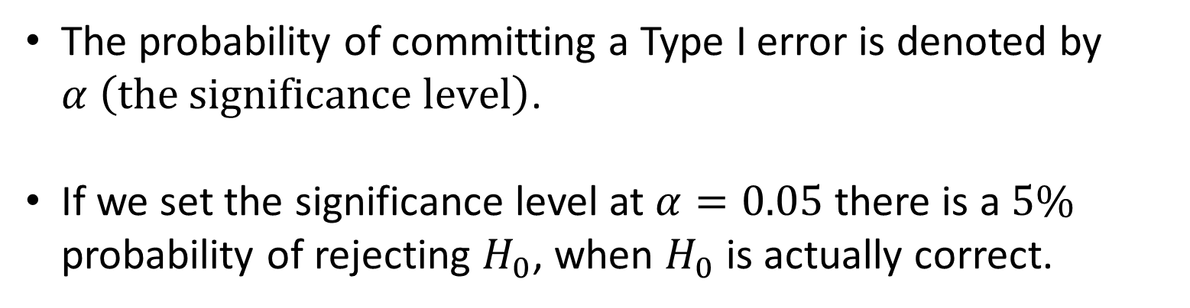
Type I errors
The probability of committing a Type I error is denoted by $α \left(the significance level\right)$.
If we set the significance level at $α=0.05$ there is a $5\%$ probability of rejecting $H_{0}$, when $H_{0}$ is actually correct.
Notes:
Use white slides to add pictures

Slide 9
Type II errors
The probability of committing a Type II error is denoted by β.
1−𝛽 𝑖𝑠 𝑘𝑛𝑜𝑤𝑛 𝑎𝑠 𝑡ℎ𝑒 𝑠𝑡𝑎𝑡𝑖𝑠𝑡𝑖𝑐𝑎𝑙 𝑝𝑜𝑤𝑒𝑟 𝑜𝑓 𝑡ℎ𝑒 𝑡𝑒𝑠𝑡.
The probability of committing a Type II error depends on several factors, including the sample size.
Notes:
Use white slides to add pictures

Slide 10
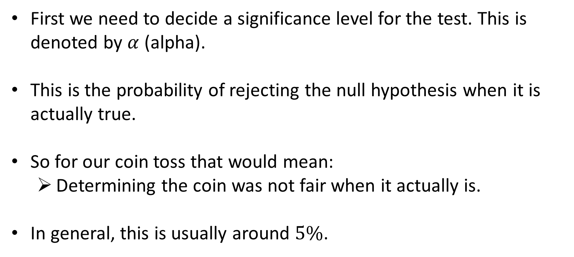
Significance level
First we need to decide a significance level for the test. This is denoted by $α$ (alpha).
This is the probability of rejecting the null hypothesis when it is actually true.
So for our coin toss that would mean:
Determining the coin was not fair when it actually is.
In general, this is usually around $5\%$.
Notes:
Use white slides to add pictures

Slide 11
Probability mass function
Most likely observation
Very unlikely observations
Very unlikely observations
Notes:
Use white slides to add pictures

Slide 12

$H_{1}:$ p $>1/{2 } , α=0.05$
Notes:
Use white slides to add pictures

Slide 13

$H_{1}:$ p $≠ 1/{2 } , α=0.05$
Notes:
Use white slides to add pictures

Slide 14
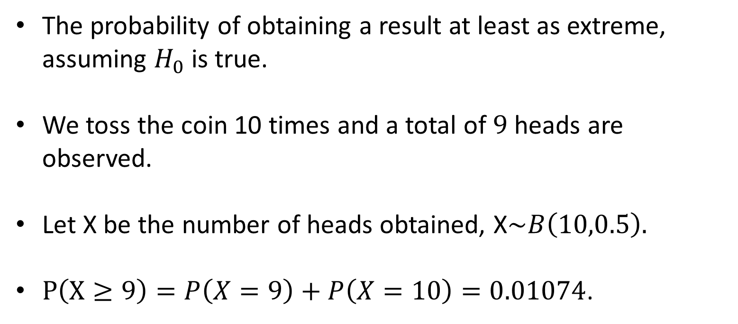
p-value
The probability of obtaining a result at least as extreme, assuming $H_{0}$ is true.
We toss the coin 10 times and a total of $9$ heads are observed.
Let X be the number of heads obtained, X$\sim B\left(10,0.5\right).$
$P\left(X≥9\right)=P\left(X=9\right)+P\left(X=10\right)=0.01074$.
Notes:
Use white slides to add pictures

Slide 15
p-value
Notes:
Use white slides to add pictures

Slide 16
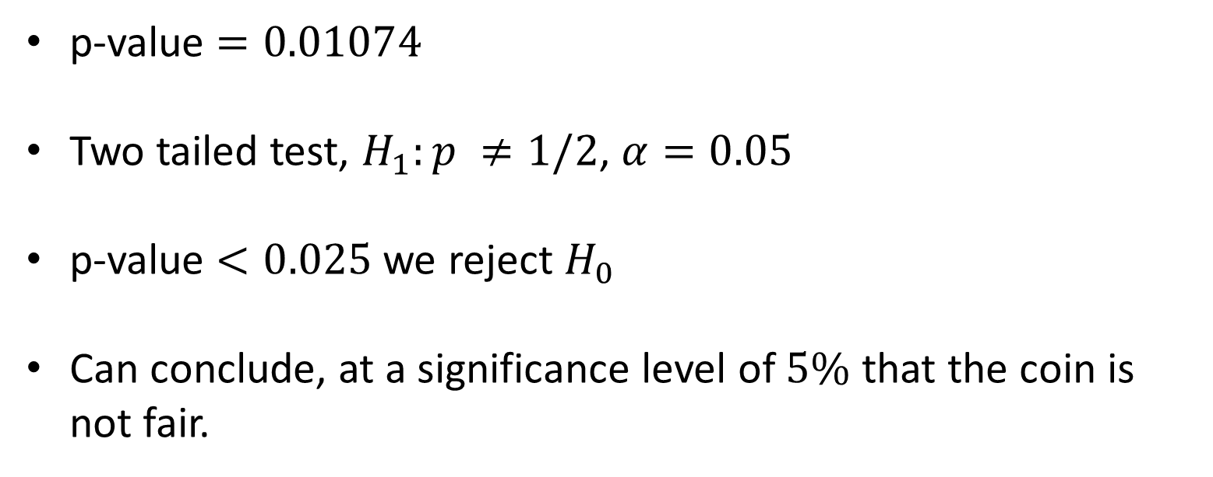
Result
p-value $=0.01074$
Two tailed test, $H_{1}:p ≠1/2$, $α=0.05$
p-value $<0.025$ we reject $H_{0}$
Can conclude, at a significance level of $5\%$ that the coin is not fair.
Notes:
Use white slides to add pictures

Slide 17
Example - Correlation
One way to quantify the relationship between two variables is to use the Pearson correlation coefficient, which is a measure of the linear association between two variables.
To determine if a correlation coefficient is statistically significant, you can calculate the corresponding test statistic and p-value.
Notes:
Use white slides to add pictures

Slide 18
Correlation coefficient
The correlation coefficient always takes on a value between -1 and 1 where:
-1 indicates a perfectly negative linear correlation between two variables
0 indicates no linear correlation between two variables
1 indicates a perfectly positive linear correlation between two variables
Notes:
Use white slides to add pictures

Slide 19
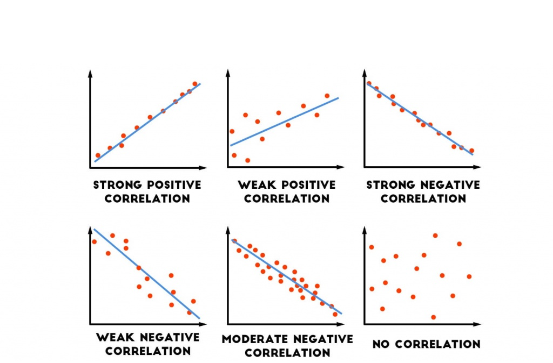
Correlation coefficent
Notes:
Use white slides to add pictures

Slide 20
Test statistic
A test statistic assesses how consistent your sample data are with the null hypothesis in a hypothesis test.
Test statistic calculations take your sample data and boil them down to a single number that quantifies how much your sample diverges from the null hypothesis.
As a test statistic value becomes more extreme, it indicates larger differences between your sample data and the null hypothesis.
Notes:
Use white slides to add pictures

Slide 21
Test statistic
When your test statistic indicates a sufficiently large incompatibility with the null hypothesis, you can reject the null and state that your results are statistically significant.
To use a test statistic to evaluate statistical significance, you either compare it to a critical value or use it to calculate the p-value.
Notes:
Use white slides to add pictures

Slide 22
Test statistic
When a t-value equals 0, it indicates that your sample data match the null hypothesis exactly.
The significance level uses critical values to define how far the test statistic must be from the null value to reject the null hypothesis.
When the test statistic exceeds a critical value, the results are statistically significant.
Notes:
Use white slides to add pictures

Slide 23
Test statistic
The formula to calculate the t-score of a correlation coefficient (r) is:
t = r * √n-2 / √1-r2
The p-value is calculated as the corresponding two-sided p-value for the t-distribution with n-2 degrees of freedom.
Notes:
Use white slides to add pictures

Slide 24
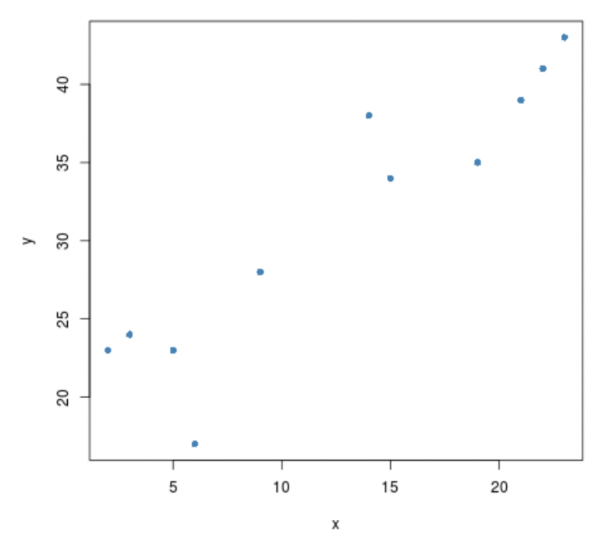
Example
Suppose we have the following 2 vectors:
x = {2, 3, 3, 5, 6, 9, 14, 15, 19, 21, 22, 23}
y = {23, 24, 24, 23, 17, 28, 38, 34, 35, 39, 41, 43}
There appears to be a positive correlation between the two variables. That is, as one increases the other tends to increase as well.
Notes:
Use white slides to add pictures

Slide 25
Example
The correlation coefficient between the two vectors turns out to be 0.9279869.
The test statistic turns out to be 7.8756 and the corresponding p-value is 1.35e-05.
Since this value is less than .05, we have sufficient evidence to say that the correlation between the two variables is statistically significant.
Notes:
Use white slides to add pictures

Slide 26
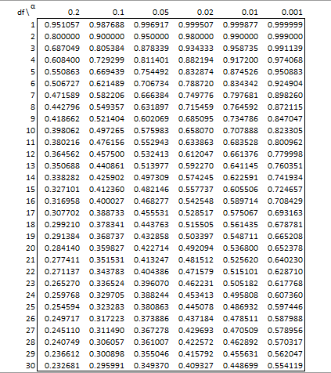
Example
Pearson's product-moment correlation
t = 7.8756, df = 10, p-value = 1.35e-05
Notes:
Use white slides to add pictures

Slide 27
Next steps
Python – independent study of Hypothesis Testing in Python course.
R - independent study of Chapter 3 of Statistics in R course.
Notes:
Use white slides to add pictures

Slide 28

Questions?
Notes:
Use white slides to add pictures

